Slide 1
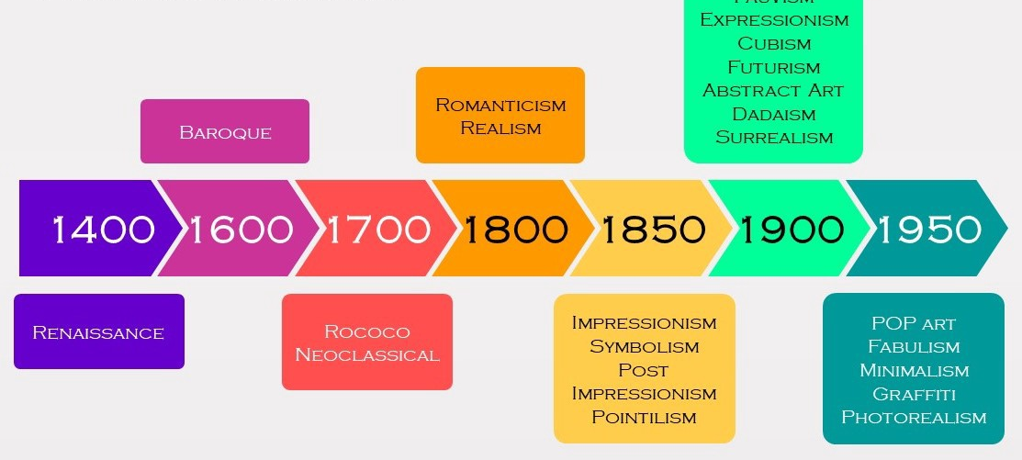
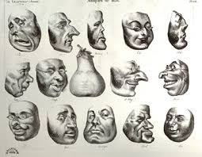
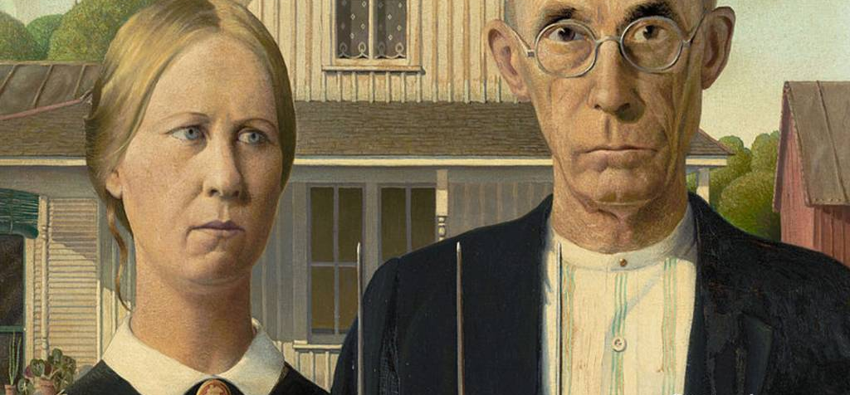



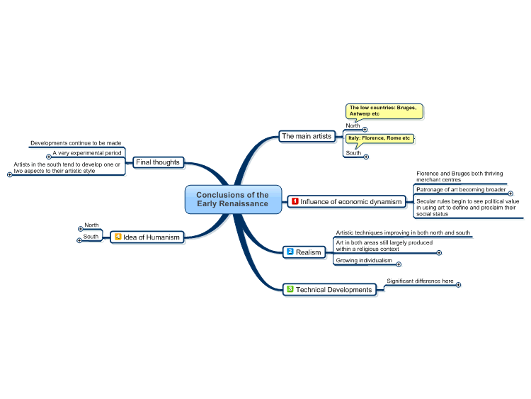



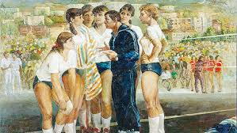
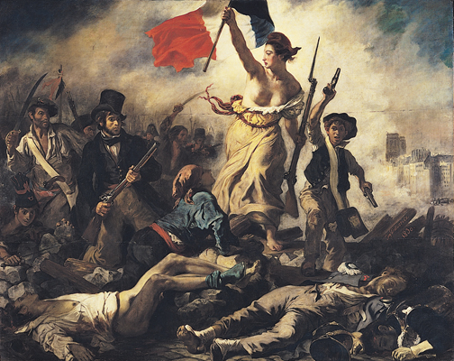




REALISM
Student Name Here
Class Number Here
Sense realism believes that knowledge primarily comes through the senses and not from words
(Falode, Adewunmi James. "The theoretical foundation of realism." Nigerian Journal of International Affairs 35.2 (2009): 35-47)
Political realism, is a view of international politics that stresses its competitive and conflictual side
(Philinthecircle. Realism Over View Phil Hansen. 2014, <https://www.youtube.com/watch?v=cump0Nxteb4>)
Social realism proposes an education system which can promote the working efficiency of individuals (Guzzini, Stefano. Realist theories and practice. No. 2017: 08. DIIS Working Paper, 2017)
The doctrine of realism asserts that there is a real world of things behind and corresponding to the objects of our perception
(TheArtAssingment. The case for Realism. 2018,< https://www.youtube.com/watch?v=Os6i6fneV-E>)
https://medium.com/@cchndn13/a-brief-history-of-art-c3d689fae01f
https://medium.com/@cchndn13/a-brief-history-of-art-c3d689fae01f
https://www.radford.edu/rbarris/art216upd2012/realism%20in%20the%2019th%20century.html
http://www.whatshappening.com.ph/event/social-realism
https://richardnilsen.com/2013/07/20/political-art-ideas-vs-ideology/e
https://www.youtube.com/watch?v=Os6i6fneV-E
Ihttps://www.hurriyetdailynews.com/socialist-realism-in-albanian-art-at-pera-museum-156590
https://www.radford.edu/rbarris/art216upd2012/realism%20in%20the%2019th%20century.html
Compare/Contrast Chart Here
Similarities / Differences
Social Political
Equality Power
Wealth Rule
Poor/Rich Ruler/Ruled
Image Identification & Activated URL Address Here
Image Identification & Activated URL Address Here

Slide 2
Bibliography
Guzzini, Stefano. Realist theories and practice. No. 2017: 08. DIIS Working Paper, 2017.
https://uu.diva-portal.org/smash/get/diva2:1163925/FULLTEXT01.pdf
Solomon, Hussein. "Realism and its Critics." Theory, Change and Southern Africa’s Future. Palgrave Macmillan, London, 2001. 34-57. https://www.sahistory.org.za/sites/default/files/archive-files/peter_vale_larry_a._swatuk_bertil_oden_theorybook4you.pdf#page=53
Falode, Adewunmi James. "The theoretical foundation of realism." Nigerian Journal of International Affairs 35.2 (2009): 35-47.
https://www.researchgate.net/publication/228277628_The_Theoretical_Foundation_of_Realism
Booth, Ken, ed. Realism and world politics. London: Routledge, 2011. https://www.fd.unl.pt/docentes_docs/ma/FPG_MA_27259.pdf
Bhaskar, Roy. A realist theory of science. Routledge, 2013. https://dl.uswr.ac.ir/bitstream/Hannan/130791/1/A%20Realistic%20Theory%20of%20science.pdf
Philinthecircle. Realism Over View Phil Hansen. 2014, <https://www.youtube.com/watch?v=cump0Nxteb4>
Nationalgalleries. What is realism? 2017, <https://www.youtube.com/watch?v=uH7h4SF2Mfg>
TheArtAssingment. The case for Realism. 2018,< https://www.youtube.com/watch?v=Os6i6fneV-E>
Deviant Art. Explore Realism. 2020, https://www.deviantart.com/tag/reaslim
Cisneros, Luis Tsukayama. "Awakened Realism: Insights From Japanese Philosophy — Yhouse". Yhouse, 2020, https://www.yhousenyc.org/events/all-events/awakened-realism-insights-from-japanese-philosophy.

